Slide 1
Educational Measurement and Item Development
An Introductory Workshop
Dr Nathanael Reinertsen
Directorate for Education and Skills

Slide 2
Workshop Overview
Day 1
What is educational measurement?
Day 2
Item Development Principles
Day 3
Item evaluation and Test Construction (from an item pool)
Day 4
Cognitive walkthroughs

Slide 3
Day 4 Outline
Cognitive Walkthroughs in Item Development
Session 1
Principles and procedures for Cognitive Walkthroughs
Session 2
Practical part 1: Preparing for Cognitive Walkthroughs
Session 3
Practical part 2: Cognitive Walkthroughs
Session 4
Workshop summary, final questions and closing.

Slide 4
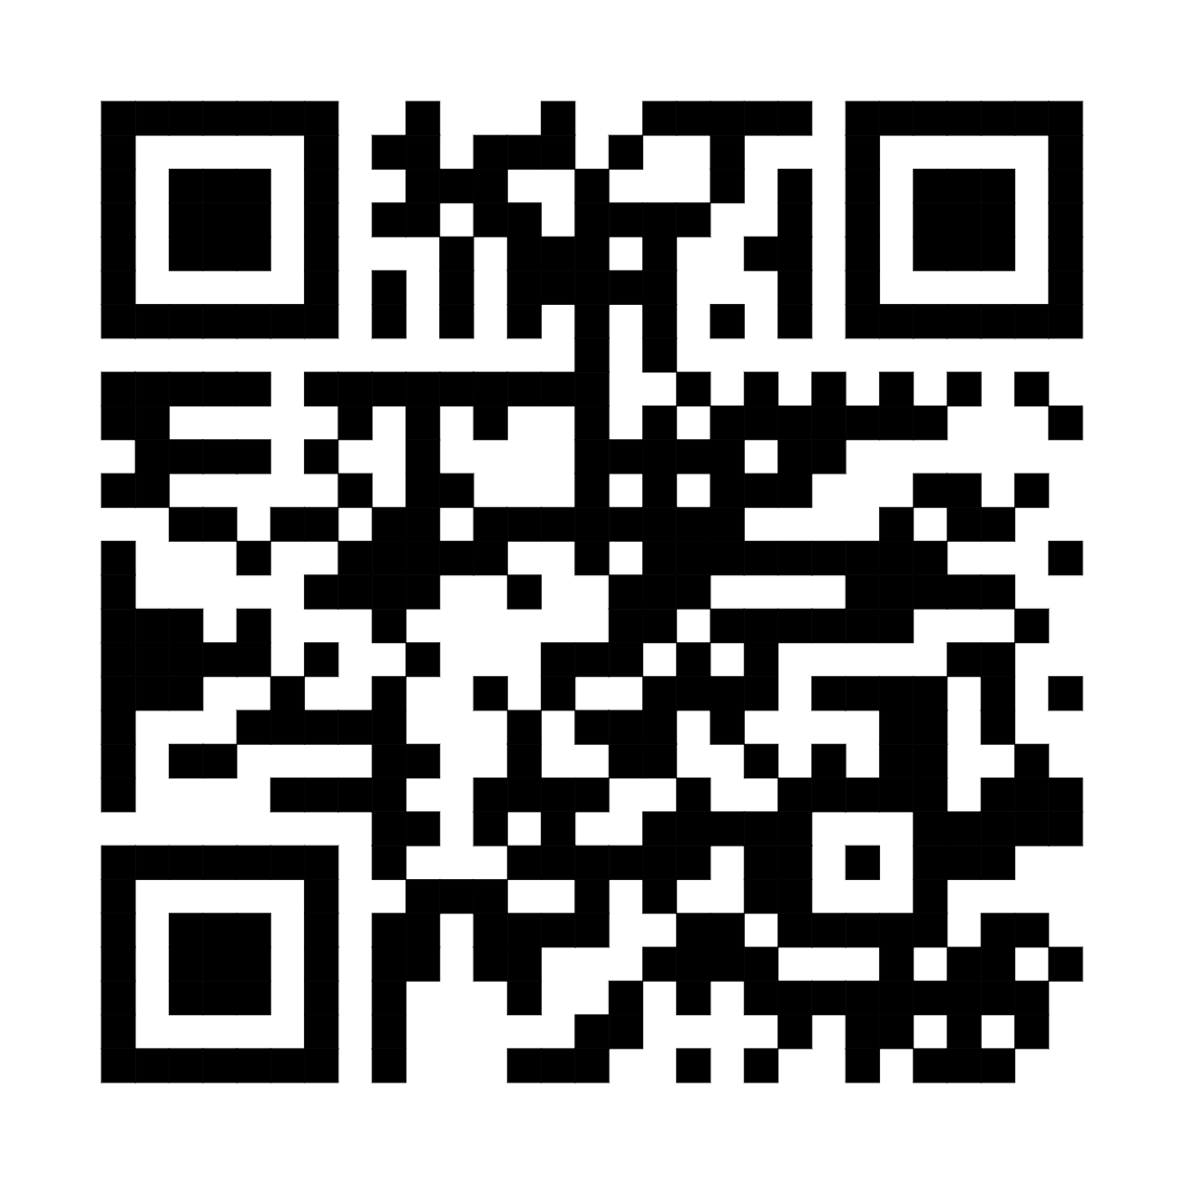
Homework Submission

Slide 5
1
Principles and procedures for Cognitive Walkthroughs

Slide 6
Item Development Overview
Drafting
Item writing
Internal Review
Cognitive Walkthroughs
External Review
Expert Review Groups
Field Trial
Psychometric review
Gather response data
Fit model(s); check item functioning
(a.k.a. ‘panels’)

Slide 7
Cognitive Walkthroughs 1: Preparation
Independent review of all units, before the CW.
Each person should make notes on all items and stimulus for:
Suitability of the content for the level of the target test candidates
Suitability of the content for the context/s of the target test candidates
Alignment of the item to the assessment framework
Accuracy of the key
Quality and ordering of the distractors
Accuracy of spelling, grammar, vocabulary, technical terms and general expression.
Notes should offer alternatives and solutions, not just point out problems.

Slide 8
Cognitive Walkthroughs 2: Procedure
The Test Development Manager (TDM) chairs the panel, but delegates to each Test Developer (TD) the chairing of the discussion for their own unit
The discussion should review (in order):
any relevant points about the stimulus
each item
All suggested edits must be agreed to by consensus
The TD who developed the unit takes notes about required edits.
Other TDs are encouraged to share any written notes they have made.
After a unit has been discussed, the TDM should determine whether the unit, given the edits to be made and the prior discussion, should be panelled again at future time or finalised by the TD.
The TDM should then invite the next TD to run the discussion on their unit.

Slide 9
Cognitive walkthroughs are emotionally difficult
You know that…
your fellow TDs are not your enemies; they are colleagues
your fellow TDs are expert critics that will improve your work
your fellow TDs are judging the unit, not you!
However…
you will feel judged
you will feel an impulse to react defensively by:
giving in / giving up / going quiet
getting angry or frustrated

Slide 10
Critical distance ‘under the spotlight’
Things to try to remember when your unit is under review:
You are not your work.
Try hard to keep in mind that all critiques are about the unit, not you.
They are not judgments about you or your intelligence, experience, capacity, etc.
It is OK to tell the group, at any point:
“I’m finding this hard. Can we take a break?”
“Can we look at another unit and come back to this one later?”

Slide 11
Critical distance as a reviewer
When you are discussing or critiquing another TD’s unit:
All your comments and questions must be directed to the whole group
Directing your questions directly to the unit writer can feel like an interrogation
Use ‘soft’ questions, inviting everyone to discuss
If you see a problem, offer a solution. That means being well-prepared!!!

Slide 12
Framing
Suggestions for giving inclusive, respectful feedback
Don’t be confrontational
Be collaborative
This is too hard for any 15-year-old.
C and D are a pair; that’s going to cause problems.
Only well-off city kids will relate to the issues in this reading passage.
I’m worried that this might be too hard for the average 15-year-old. What do you all think?
Options C and D both start with the word ‘consider’, so what do you all think about changing D to start with ‘think about’?
I was wondering about the readers who will be able to relate to this stimulus. What sorts of people do you all think they might be?

Slide 13
Be kind to each other
Even with colleagues you trust, who are being as inclusive as possible in their feedback, be prepared to feel judged.
Acknowledge your emotions; they are normal.
Ask for a break if you need it.
Be aware of how the unit writer is reacting to the discussion and feedback.
Don’t wait for them to ask for a break: if you think they might need one, offer one.

Slide 14
2
Practical part 1: Preparing for Cognitive Walkthroughs

Slide 15
Mental checklist
Suitability of the content for the level of the target test candidates
Suitability of the content for the context/s of the target test candidates
Content overlap in items
Alignment of the item to the assessment framework
Correct framework variables (cognitive process, item intent, etc.)
Accuracy of the key
Quality and ordering of the distractors
Accuracy of spelling, grammar, vocabulary, technical terms and general expression.
Remember: Have suggested changes already written!

Slide 16
3
Practical part 2: Cognitive Walkthroughs

Slide 17
Discussion procedure
Review of stimulus
Review of first item
Review of second item
Review of third item
Final remarks

Slide 18
Sharing session
Pick one to share about your group’s Cognitive Walkthrough:
What made the discussion good/enjoyable?
What was one difficult thing about the exercise?
Is it a process you could see implementing?

Slide 19
4
Summary

Slide 20
Workshop Recap
Item Development Principles
MC and CR items
Using AI in the development process
Item evaluation
CTT
Rasch Measurement/IRT
Test construction and test evaluation
Booklet designs
Test equating
Cognitive Walkthroughs in Item Development
The role and process of collaborative review in item development
What is educational measurement?
Measurement concepts
Assessment Frameworks
Validity

Slide 21
Workshop aims
Workshop participants should gain…
1
Knowledge of educational measurement theory
2
Deeper understanding of PISA-style, large-scale assessments
3
Enhanced item and test development skills
4
Increased assessment literacy

Slide 22

Feedback, please!!!

Slide 23
Thank you

